Slide 1

Chapter 7
Advanced Encryption Standard
(AES)
7.<number>
Copyright © The McGraw-Hill Companies, Inc. Permission required for reproduction or display.

Slide 2
Chapter 7
Objectives
❏ To review a short history of AES
❏ To define the basic structure of AES
❏ To define the transformations used by AES
❏ To define the key expansion process
❏ To discuss different implementations
7.<number>

Slide 3
7-1 INTRODUCTION
The Advanced Encryption Standard (AES) is a symmetric-key block cipher published by the National Institute of Standards and Technology (NIST) in December 2001.
Topics discussed in this section:
7.1.1 History
7.1.2 Criteria
7.1.3 Rounds
7.1.4 Data Units
7.1.5 Structure of Each Round
7.<number>

Slide 4
7.1.1 History.
In February 2001, NIST announced that a draft of the Federal Information Processing Standard (FIPS) was available for public review and comment. Finally, AES was published as FIPS 197 in the Federal Register in December 2001.
7.<number>

Slide 5
7.1.2 Criteria
The criteria defined by NIST for selecting AES fall into three areas:
1. Security – resistance to cryptanalysis
2. Cost - computational efficiency and storage requirements for different implementations
3. Implementation – platform flexibility and simplicity
7.<number>

Slide 6

7.1.3 Rounds.
AES is a non-Feistel cipher that encrypts and decrypts a data block of 128 bits. It uses 10, 12, or 14 rounds. The key size, which can be 128, 192, or 256 bits, depends on the number of rounds.
Note
AES has defined three versions, with 10, 12, and 14 rounds.
Each version uses a different cipher key size (128, 192, or 256), but the round keys are always 128 bits.
7.<number>

Slide 7
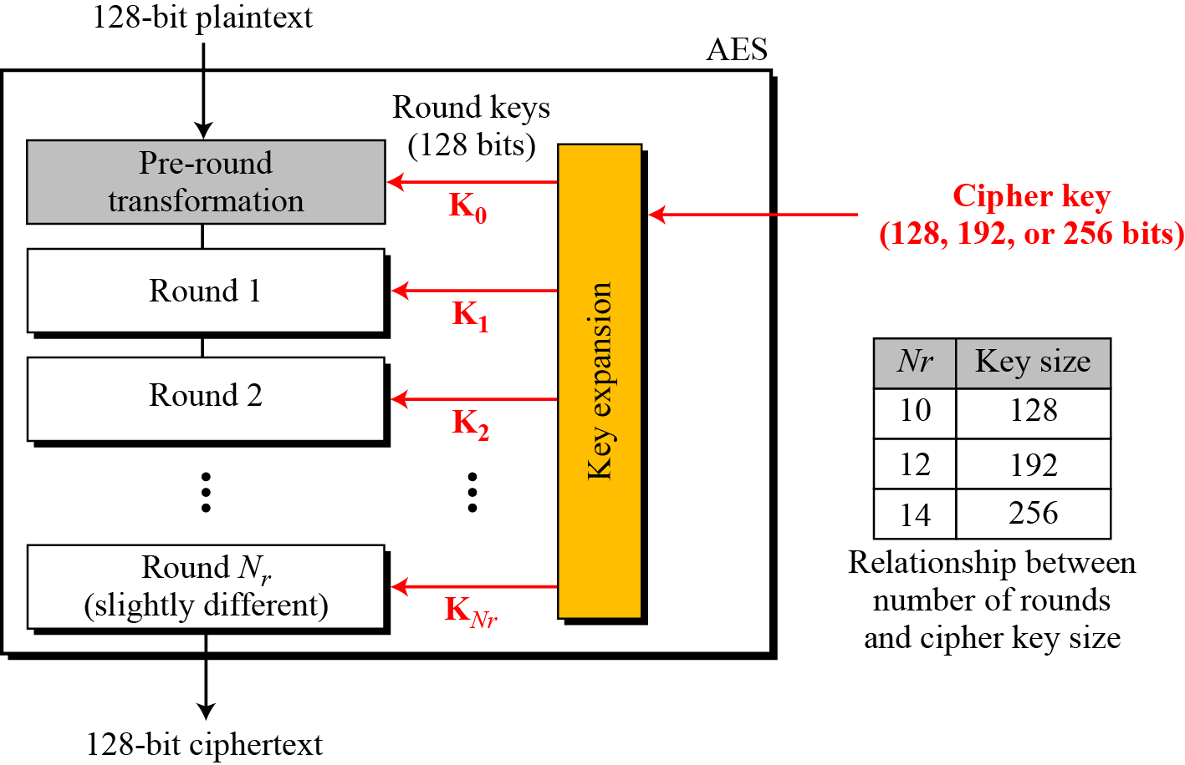
7.1.3 Continue
Figure 7.1 General design of AES encryption cipher
7.<number>

Slide 8
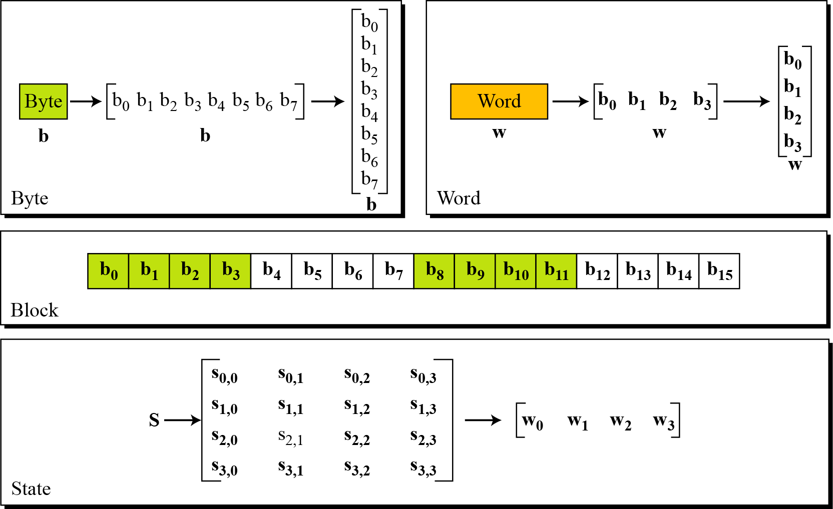
7.1.4 Data Units.
Figure 7.2 Data units used in AES
7.<number>

Slide 9
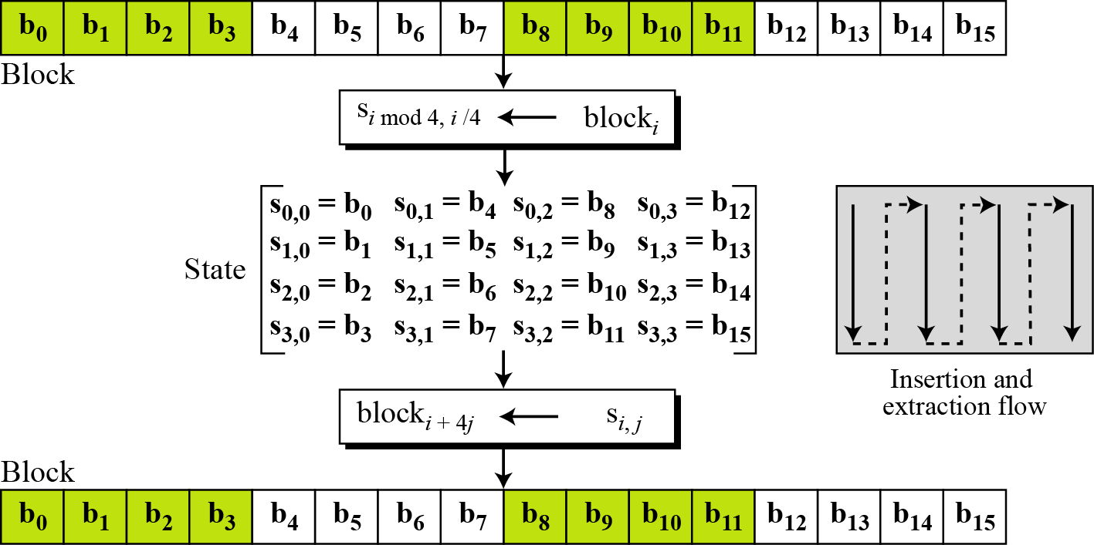
7.1.4 Continue
Figure 7.3 Block-to-state and state-to-block transformation
7.<number>

Slide 10
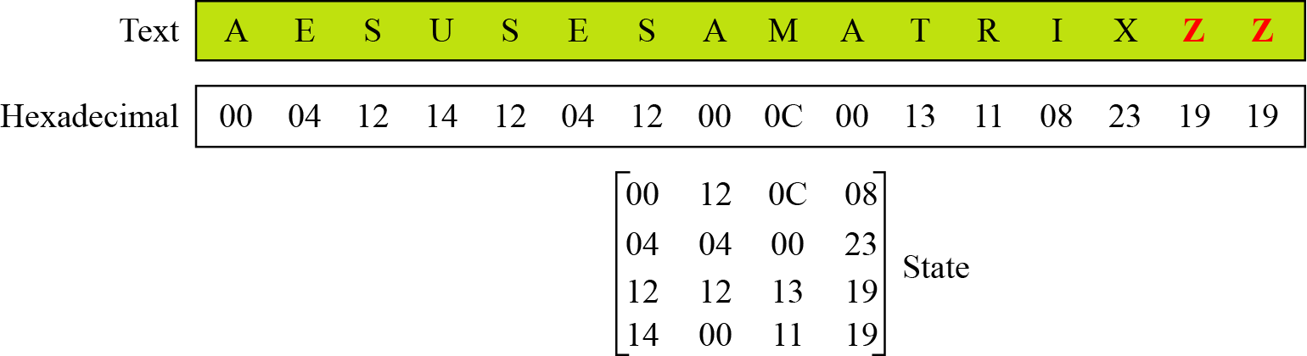
7.1.4 Continue
Example 7.1
Continue
Figure 7.4 Changing plaintext to state
7.<number>

Slide 11
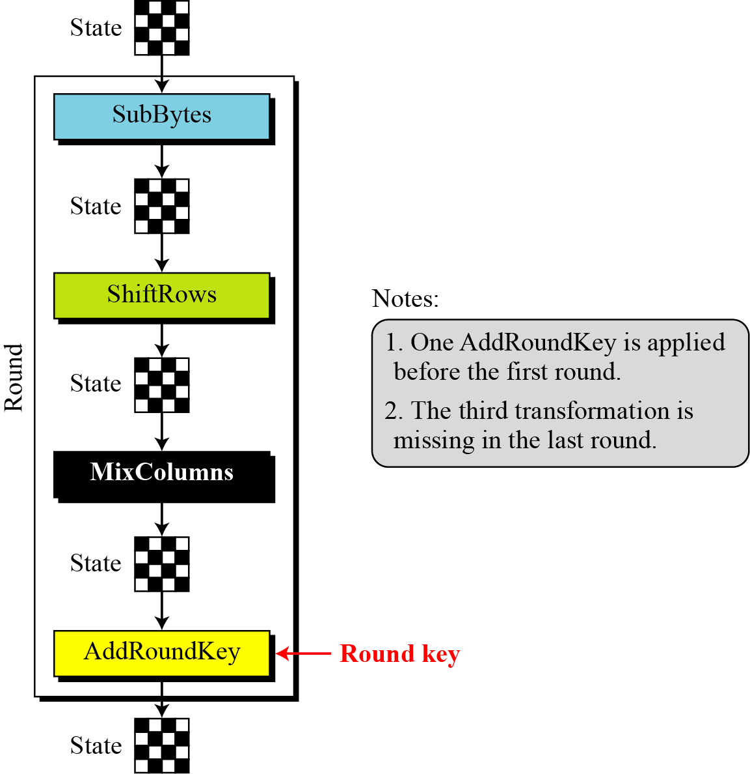
7.1.5 Structure of Each Round
Figure 7.5 Structure of each round at the encryption site
7.<number>

Slide 12
7-2 TRANSFORMATIONS
To provide security, AES uses four types of transformations: substitution, permutation, mixing, and key-adding.
Topics discussed in this section:
7.2.1 Substitution
7.2.2 Permutation
7.2.3 Mixing
7.2.4 Key Adding
7.<number>

Slide 13
Substitution
Substitution is done for every byte
Only one table is used for transformation of every byte, i.e., if two bytes are same, transformation is also same.
Transformation is defined by a lookup table or mathematical calculation in GF(2⁸)field.
7.<number>

Slide 14
7.2.1 Substitution
AES, like DES, uses substitution. AES uses two invertible transformations.
SubBytes
The first transformation, SubBytes, is used at the encryption site.
To substitute a byte, we interpret the byte as two hexadecimal digits.
Left digit defines row while right digit defines column in substitution table.
The SubBytes operation involves 16 independent byte-to-byte transformations.
7.<number>

Slide 15
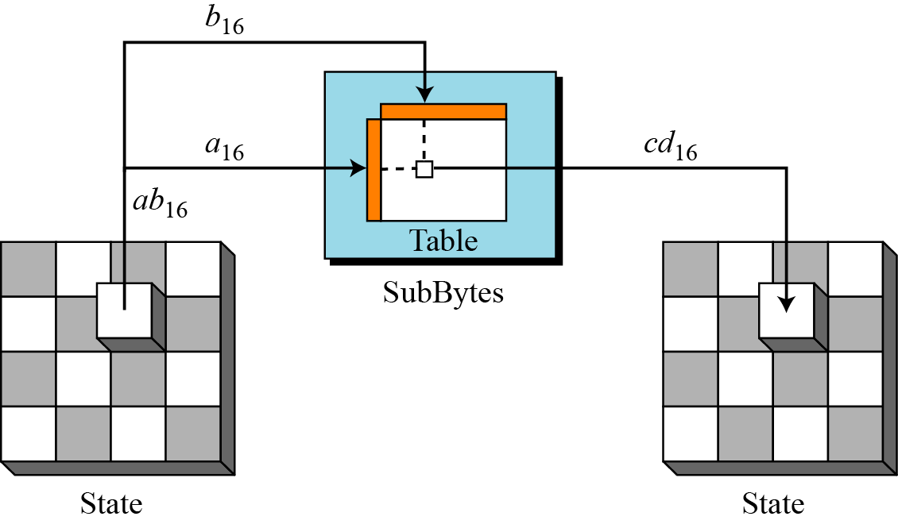
7.2.1 Continue
Figure 7.6 SubBytes transformation
7.<number>

Slide 16
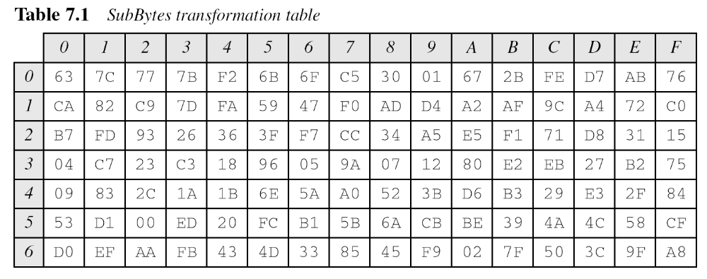
7.2.1 Continue
7.<number>

Slide 17
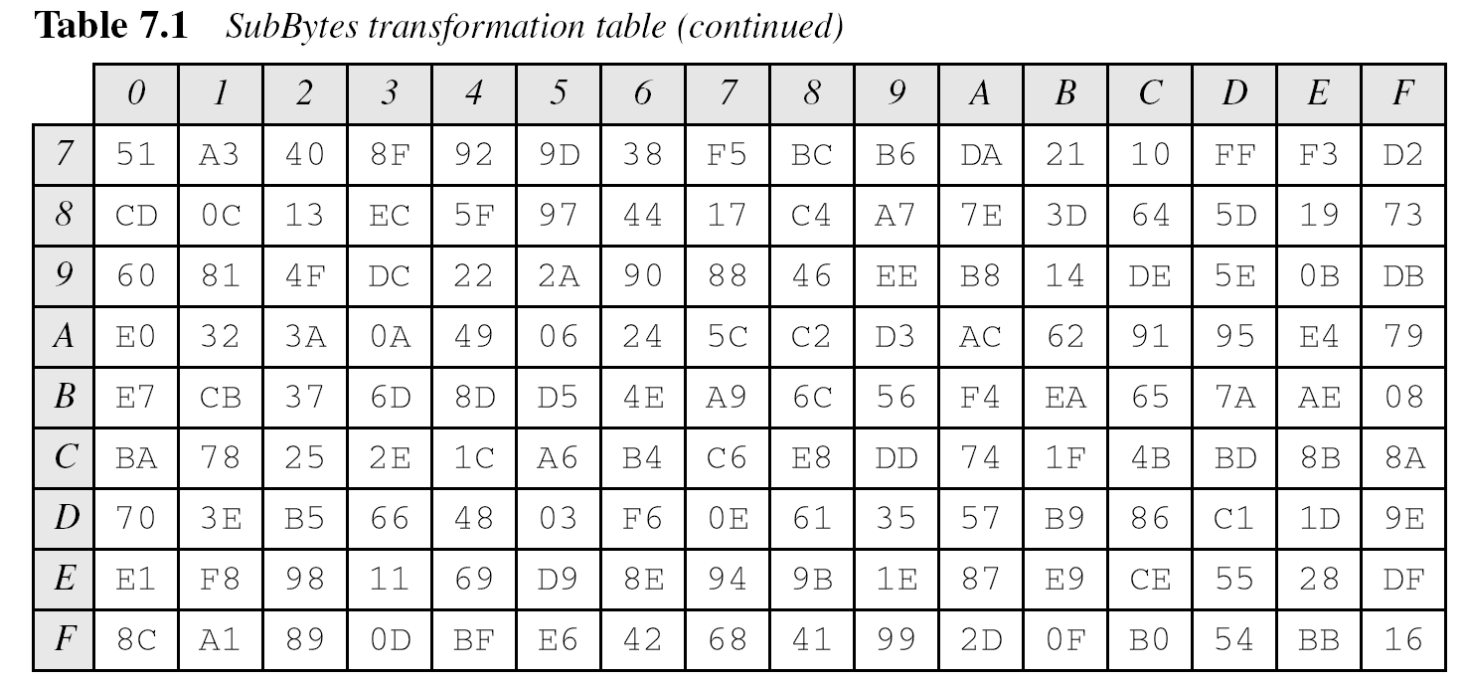
7.2.1 Continue
7.<number>

Slide 18
7.2.1 Continue
InvSubBytes
7.<number>

Slide 19
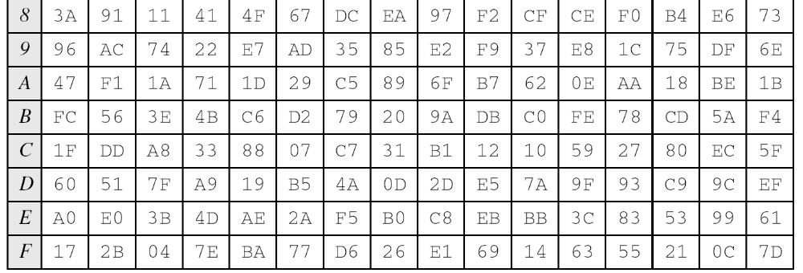
7.2.1 Continue
InvSubBytes (Continued)
7.<number>

Slide 20
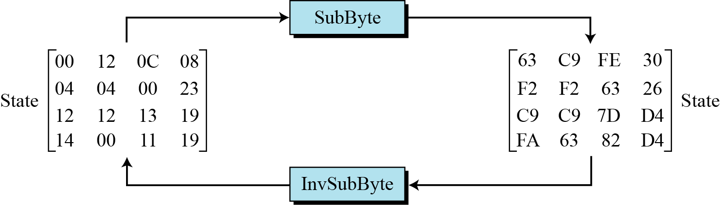
7.2.1 Continue
Example 7.2
Figure 7.7 shows how a state is transformed using the SubBytes transformation. The figure also shows that the InvSubBytes transformation creates the original one. Note that if the two bytes have the same values, their transformation is also the same.
Figure 7.7 SubBytes transformation for Example 7.2
7.<number>

Slide 21
7.2.1 Continue
Transformation Using the GF(2⁸) Field
AES also defines the transformation algebraically using the GF(28) field with the irreducible polynomials
(x⁸ + x⁴ + x³+ x + 1), as shown in Figure 7.8.
Note
The SubBytes and InvSubBytes transformations are inverses of each other.
7.<number>

Slide 22
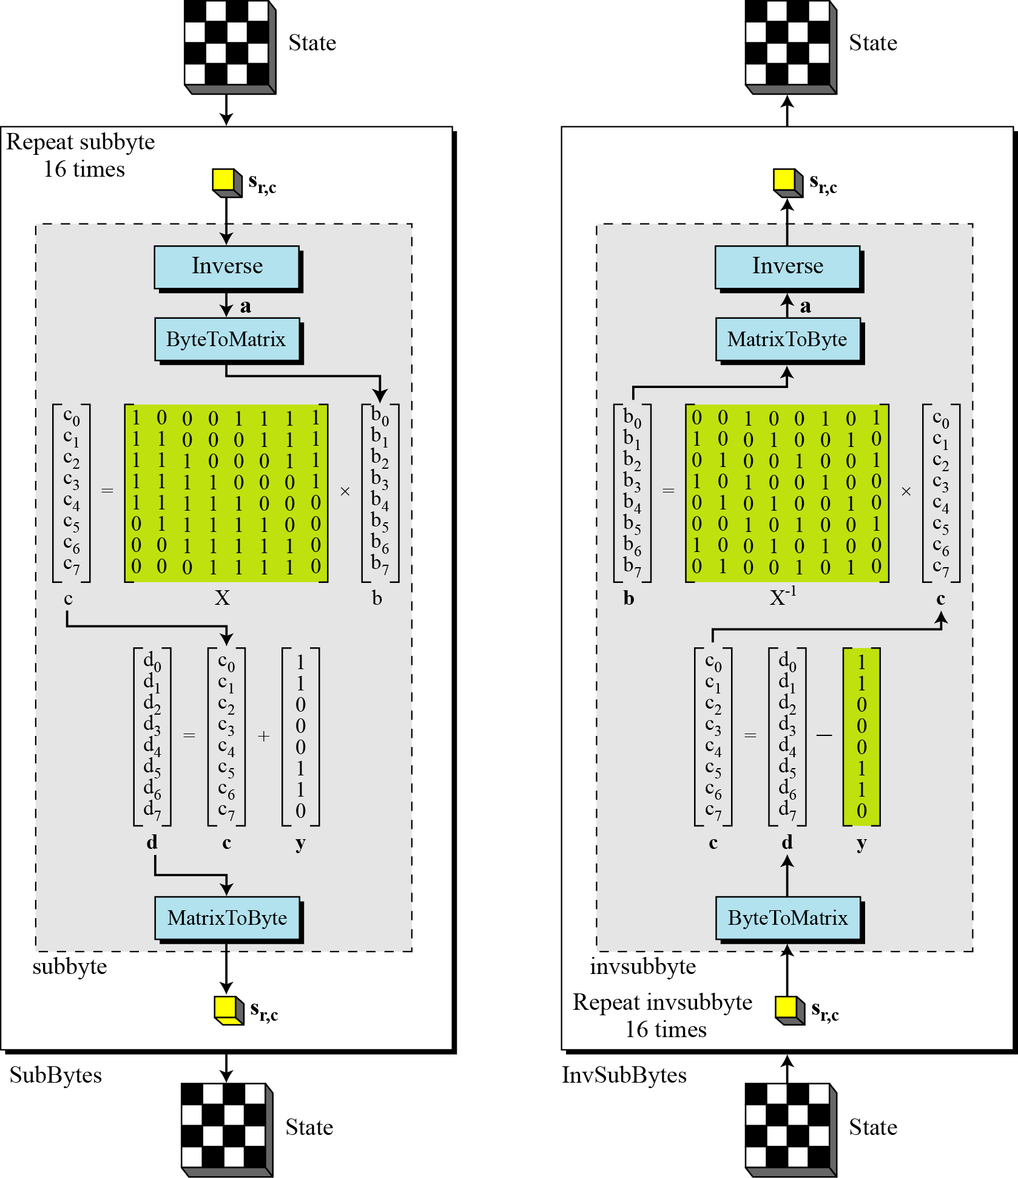
7.2.1 Continue
Figure 7.8 SubBytes and InvSubBytes processes
7.<number>

Slide 23
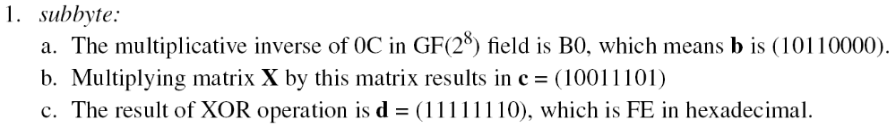
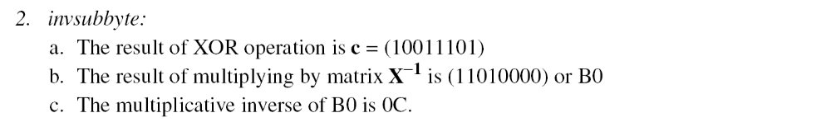
7.2.1 Continue
Example 7.3
Let us show how the byte 0C is transformed to FE by subbyte
routine and transformed back to 0C by the invsubbyte routine.
7.<number>

Slide 24
7.2.1 Continue
7.<number>

Slide 25
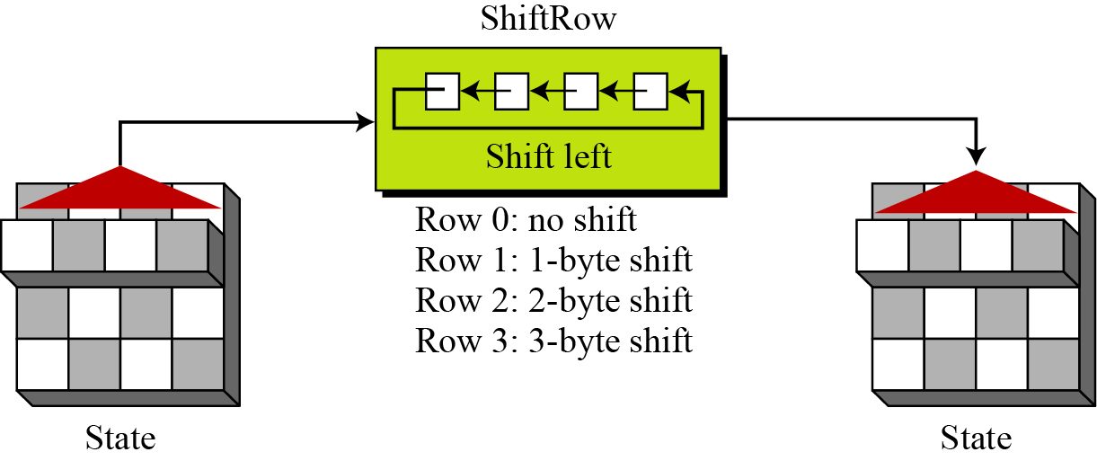
7.2.2 Permutation
Another transformation found in a round is shifting, which permutes the bytes.
ShiftRows
In the encryption, the transformation is called ShiftRows.
Figure 7.9 ShiftRows transformation
7.<number>

Slide 26
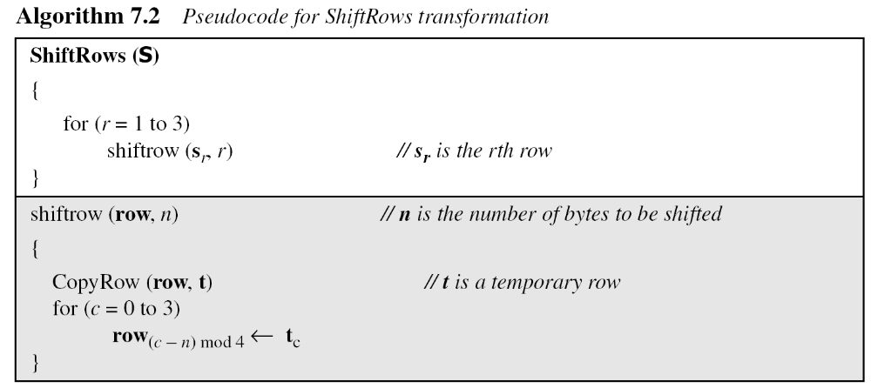
7.2.2 Continue
InvShiftRows
In the decryption, the transformation is called InvShiftRows and the shifting is to the right.
7.<number>

Slide 27
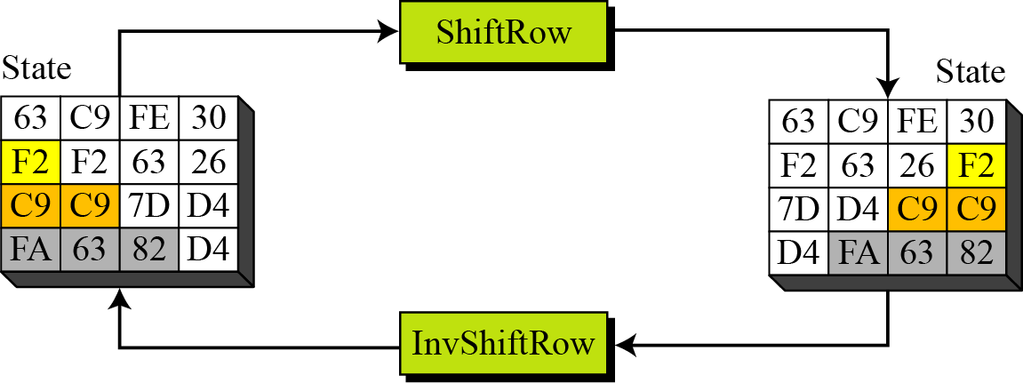
7.2.2 Continue
Example 7.4
Figure 7.10 shows how a state is transformed using ShiftRows transformation. The figure also shows that InvShiftRows transformation creates the original state.
Figure 7.10 ShiftRows transformation in Example 7.4
7.<number>

Slide 28
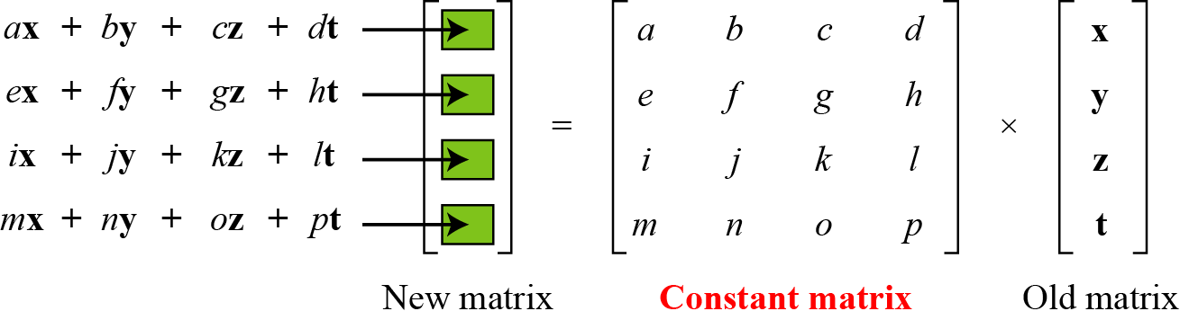
7.2.3 Mixing
We need an interbyte transformation that changes the bits inside a byte, based on the bits inside the neighboring bytes. We need to mix bytes to provide diffusion at the bit level.
Figure 7.11 Mixing bytes using matrix multiplication
7.<number>

Slide 29
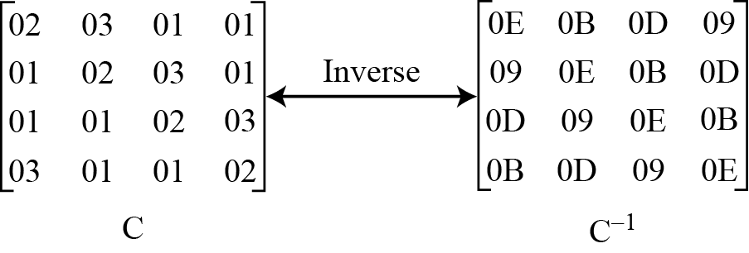
7.2.3 Continue
Figure 7.12 Constant matrices used by MixColumns and InvMixColumns
7.<number>

Slide 30
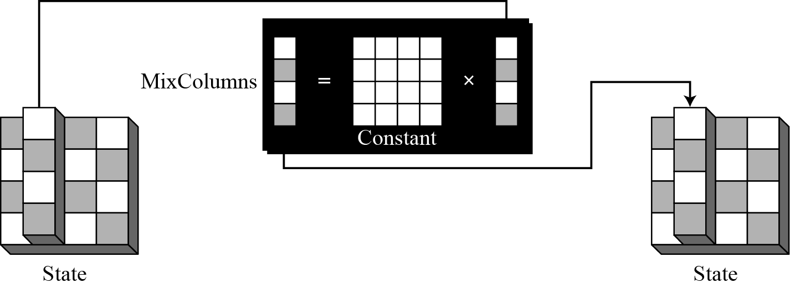
7.2.3 Continue
MixColumns
The MixColumns transformation operates at the column level; it transforms each column of the state to a new column.
Figure 7.13 MixColumns transformation
7.<number>

Slide 31
7.2.3 Continue
InvMixColumns
The InvMixColumns transformation is basically the same as the MixColumns transformation.
Note
The MixColumns and InvMixColumns transformations are inverses of each other.
7.<number>

Slide 32
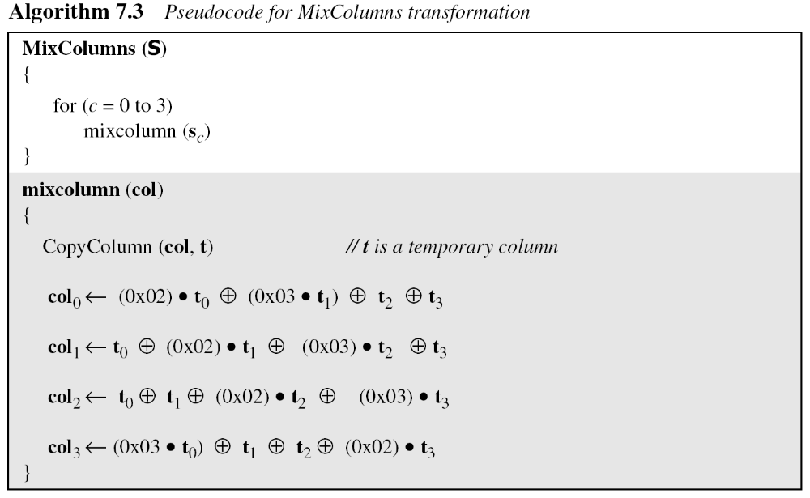
7.2.3 Continue
7.<number>

Slide 33
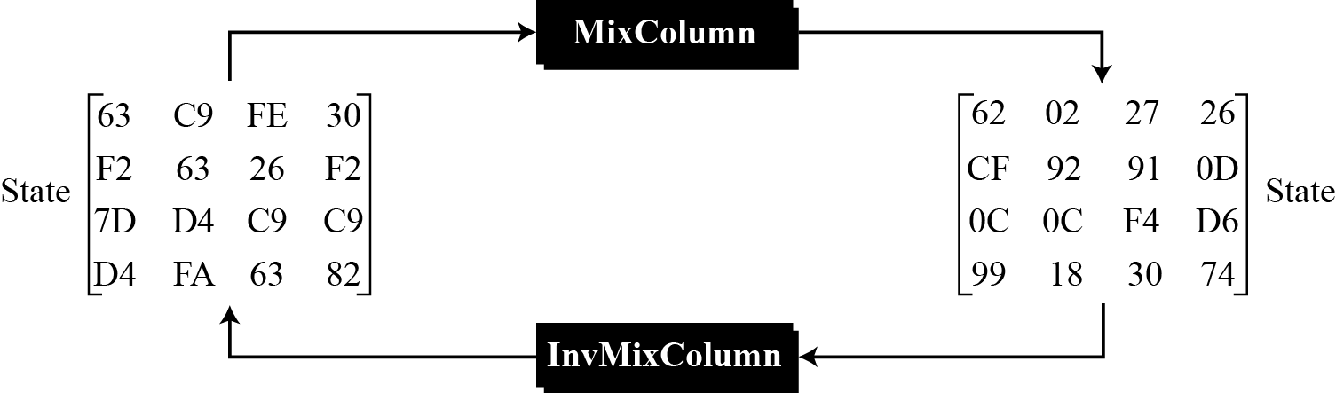
7.2.3 Continue
Example 7.5
Figure 7.14 shows how a state is transformed using the MixColumns transformation. The figure also shows that the InvMixColumns transformation creates the original one.
Figure 7.14 The MixColumns transformation in Example 7.5
7.<number>

Slide 34
7.2.4 Key Adding
AddRoundKey
AddRoundKey proceeds one column at a time. AddRoundKey adds a round key word with each state column matrix; the operation in AddRoundKey is matrix addition.
Note
The AddRoundKey transformation is the inverse of itself.
7.<number>

Slide 35
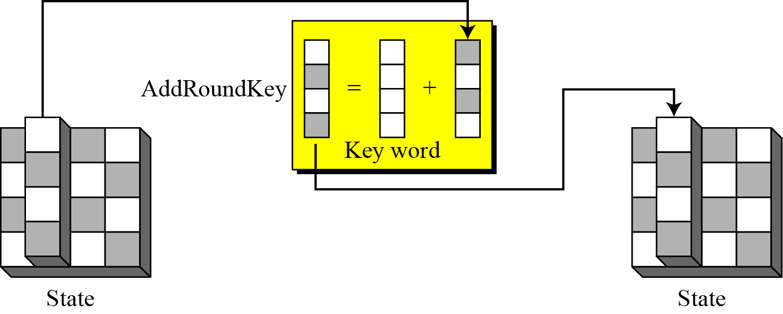
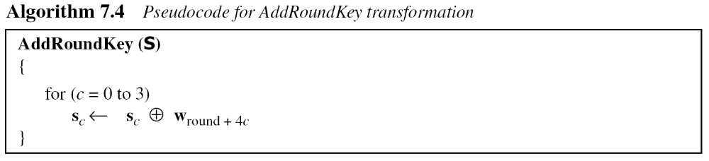
7.2.4 Continue
Figure 7.15 AddRoundKey transformation
7.<number>

Slide 36
7-3 KEY EXPANSION
To create round keys for each round, AES uses a key-expansion process. If the number of rounds is N_{r} , the key-expansion routine creates N_{r} + 1 128-bit round keys from one single 128-bit cipher key.
Topics discussed in this section:
7.3.1 Key Expansion in AES-128
7.3.2 Key Expansion in AES-192 and AES-256
7.3.3 Key-Expansion Analysis
7.<number>

Slide 37
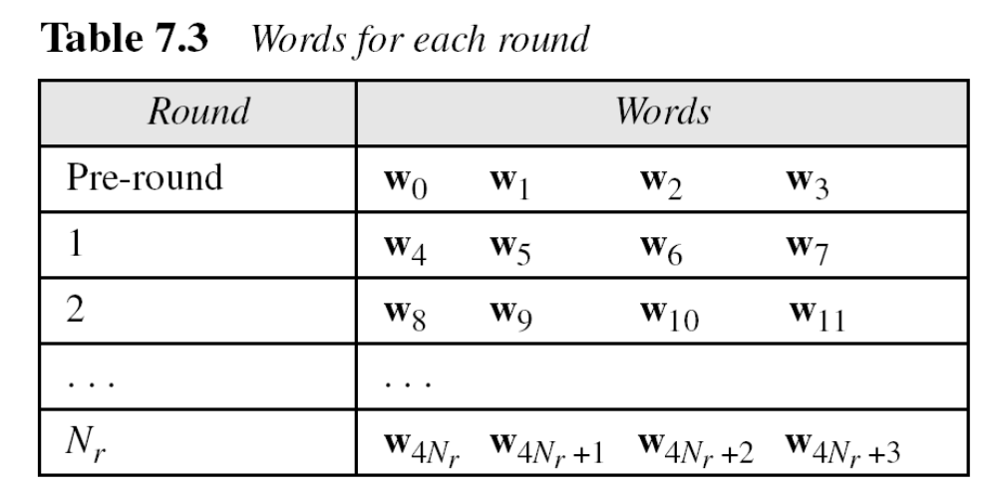
7-3 Continued
7.<number>

Slide 38
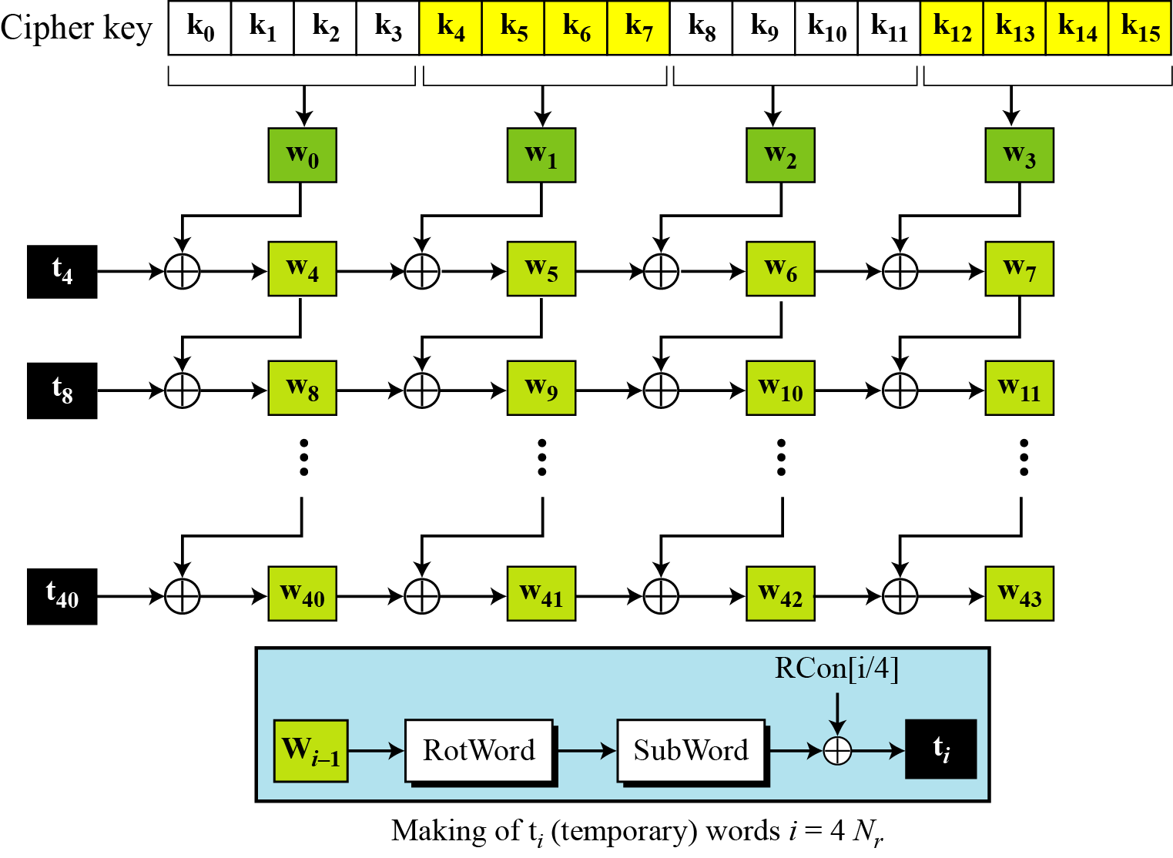
7.3.1 Key Expansion in AES-128
Figure 7.16 Key expansion in AES
7.<number>

Slide 39
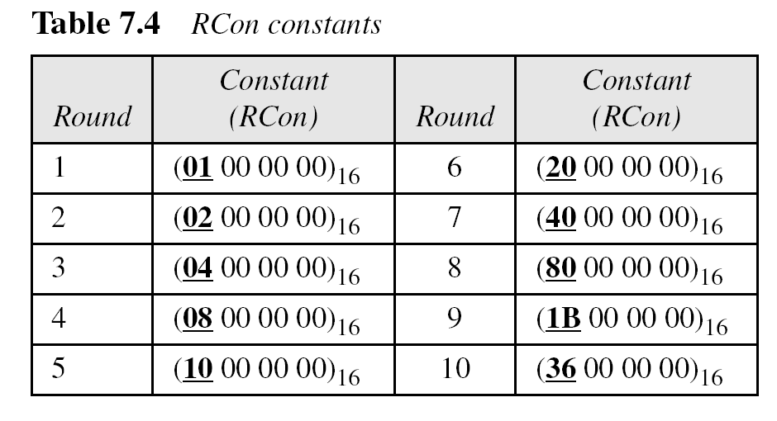
7.3.1 Continue
7.<number>

Slide 40
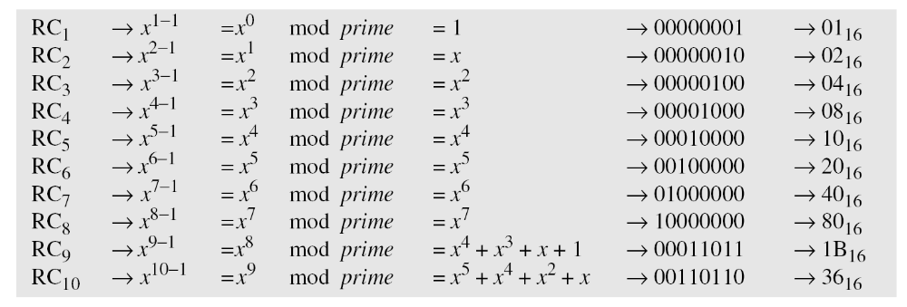
7.3.1 Continue
The key-expansion routine can either use the above table when calculating the words or use the GF(2⁸) field to calculate the leftmost byte dynamically, as shown below (prime is the irreducible polynomial):
7.<number>

Slide 41
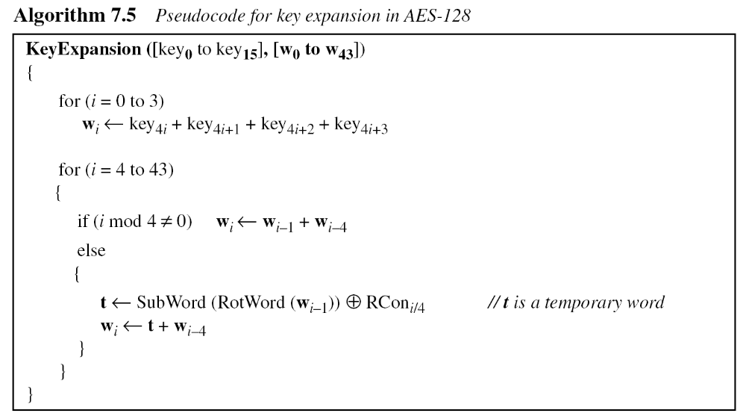
7.3.1 Continue
7.<number>

Slide 42
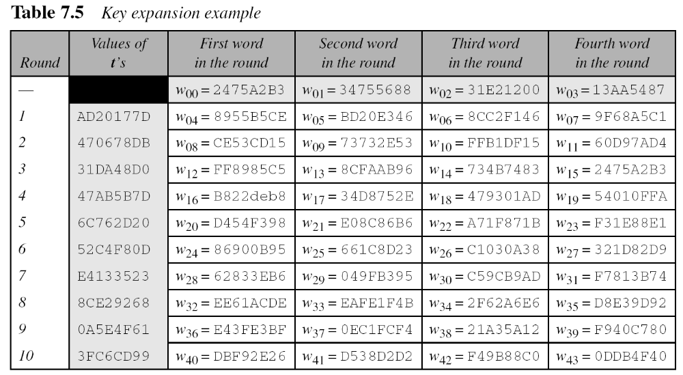
7.3.1 Continue
Example 7.6
Table 7.5 shows how the keys for each round are calculated assuming that the 128-bit cipher key agreed upon by Alice and Bob is (24 75 A2 B3 34 75 56 88 31 E2 12 00 13 AA 54 87)₁₆.
7.<number>

Slide 43
7.3.1 Continue
Example 7.7
Each round key in AES depends on the previous round key. The dependency, however, is nonlinear because of SubWord transformation. The addition of the round constants also guarantees that each round key will be different from the previous one.
Example 7.8
The two sets of round keys can be created from two cipher keys that are different only in one bit.
7.<number>

Slide 44
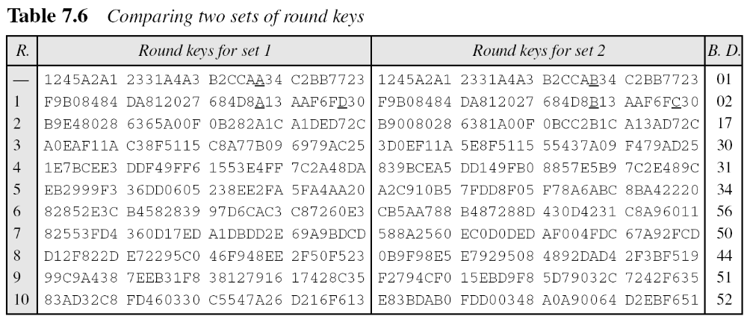
7.3.1 Continue
Example 7.8
Continue
7.<number>

Slide 45
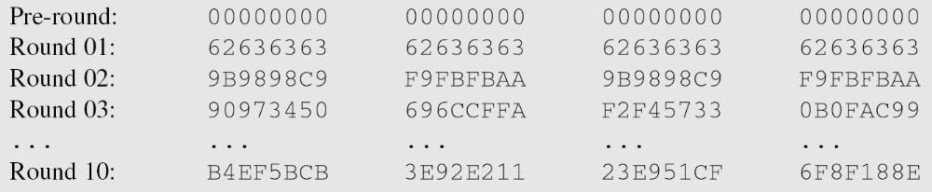
7.3.1 Continue
Example 7.9
The concept of weak keys, as we discussed for DES in Chapter 6, does not apply to AES. Assume that all bits in the cipher key are 0s. The following shows the words for some rounds:
The words in the pre-round and the first round are all the same. In the second round, the first word matches with the third; the second word matches with the fourth. However, after the second round the pattern disappears; every word is different.
7.<number>

Slide 46
7.3.2 Key Expansion in AES-192 and AES-256
Key-expansion algorithms in the AES-192 and AES-256 versions are very similar to the key expansion algorithm in AES-128, with the following differences:
7.<number>

Slide 47
7.3.3 Key-Expansion Analysis
The key-expansion mechanism in AES has been designed to provide several features that thwart the cryptanalyst.
7.<number>

Slide 48
7-4 CIPHERS
AES uses four types of transformations for encryption and decryption. In the standard, the encryption algorithm is referred to as the cipher and the decryption algorithm as the inverse cipher.
Topics discussed in this section:
7.4.1 Original Design
7.4.2 Alternative Design
7.<number>

Slide 49
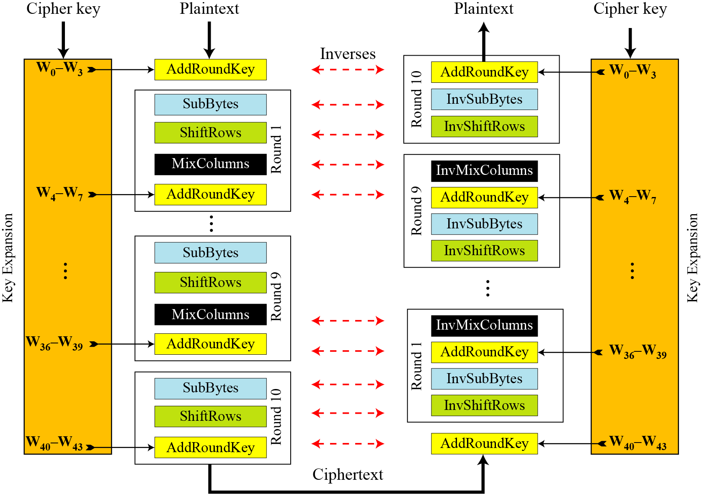
7.4.1 Original Design
Figure 7.17 Ciphers and inverse ciphers of the original design
7.<number>

Slide 50
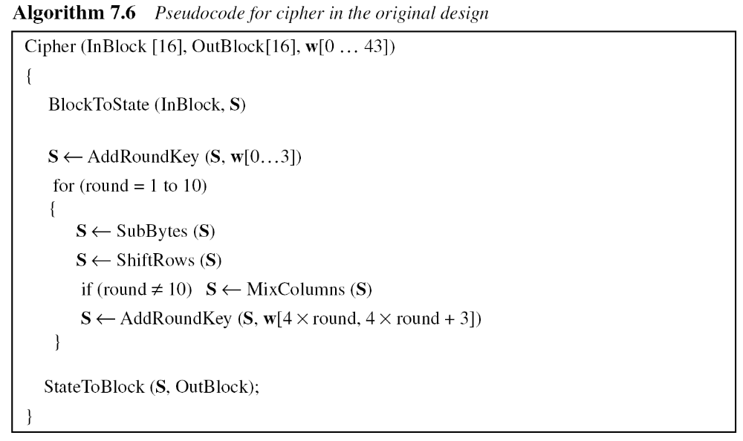
7.4.1 Continue
Algorithm
The code for the AES-128 version of this design is shown in Algorithm 7.6.
7.<number>

Slide 51
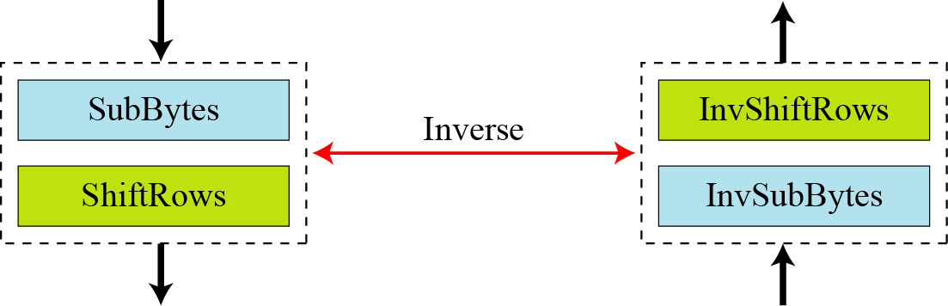
7.4.2 Alternative Design
Figure 7.18 Invertibility of SubBytes and ShiftRows combinations
Invertibility is provided for a pair of transformations and not for each single transformation.
SubByets change contents without changing order
ShiftRows change order without changing contents
7.<number>

Slide 52
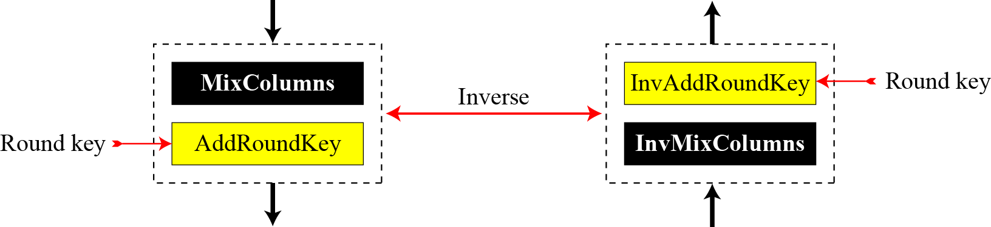
7.4.2 Continue
Figure 7.19 Invertibility of MixColumns and AddRoundKey combination
The pair operation becomes inverses of each other if we multiply the key matrix by inverse of constant matrix used in MixColumns transformation
7.<number>

Slide 53
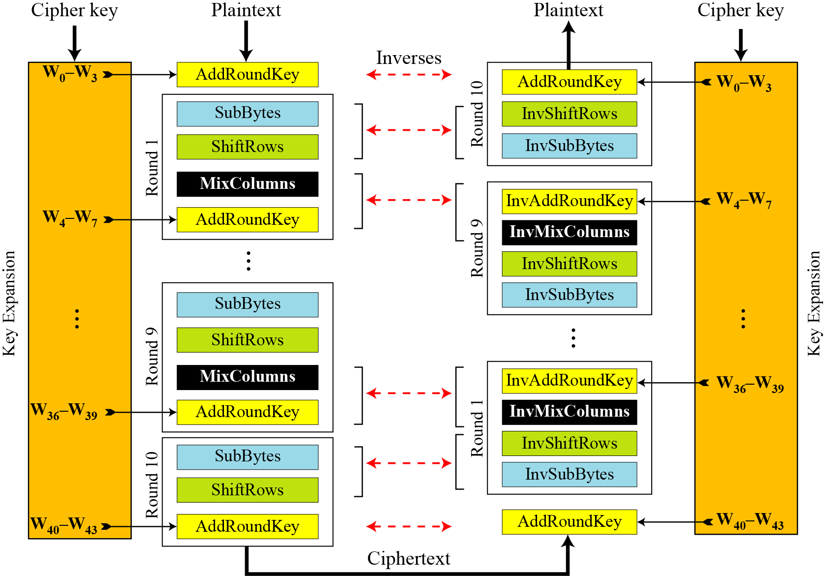
7.4.2 Continue
Figure 7.20 Cipher and reverse cipher in alternate design
7.<number>

Slide 54
7.4.2 Continue
Changing Key-Expansion Algorithm
Instead of using InvRoundKey transformation in the reverse cipher, the key-expansion algorithm can be changed to create a different set of round keys for the inverse cipher.
Round key for pre-round operation and last round should not be changed
The round keys for round 1 to 9 need to be multiplied by the constant matrix
7.<number>

Slide 55
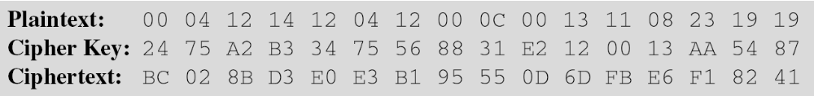
7-5 Examples
In this section, some examples of encryption/ decryption and key generation are given to emphasize some points discussed in the two previous sections.
Example 7.10
The following shows the ciphertext block created from a plaintext block using a randomly selected cipher key.
7.<number>

Slide 56
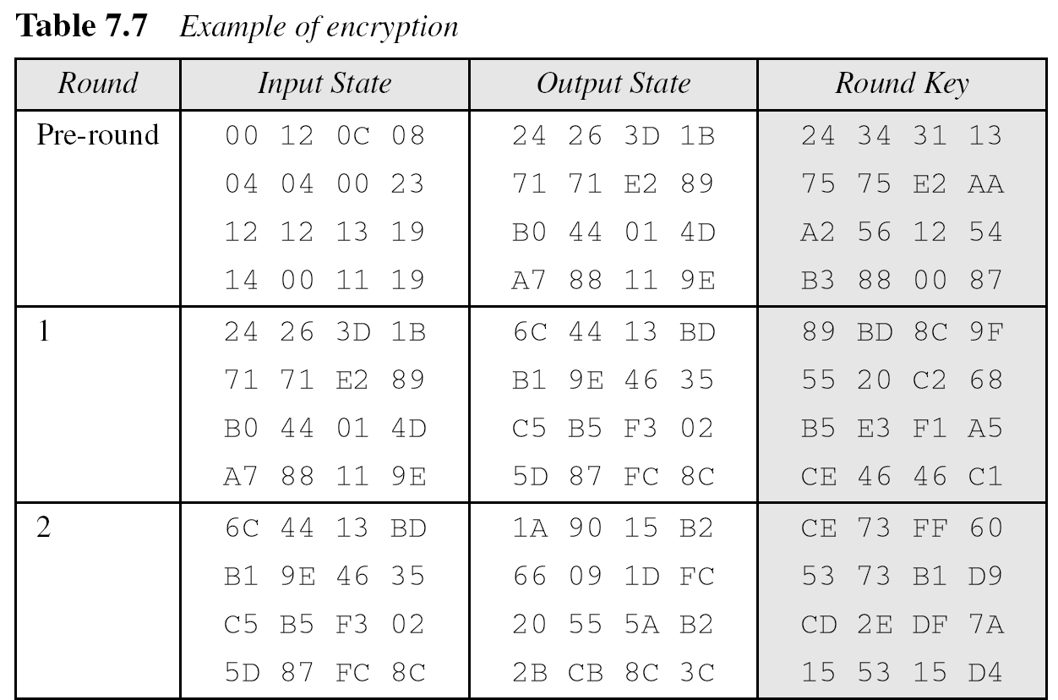
7-5 Continued
Example 7.10
Continued
7.<number>

Slide 57
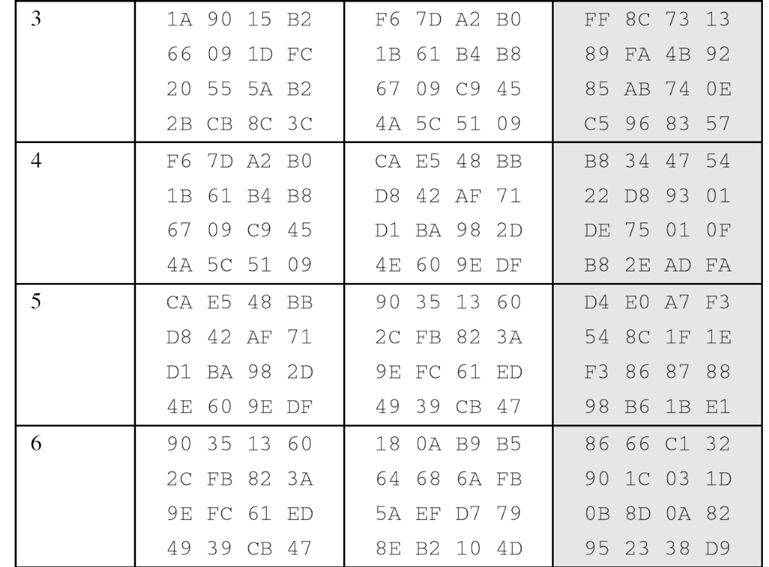
7-5 Continued
Example 7.10
Continued
7.<number>

Slide 58
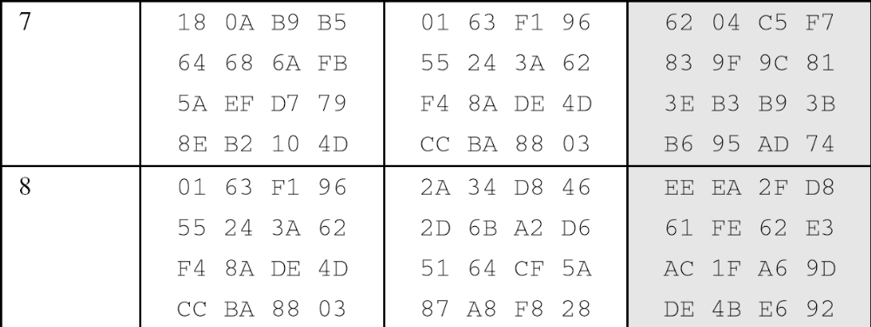
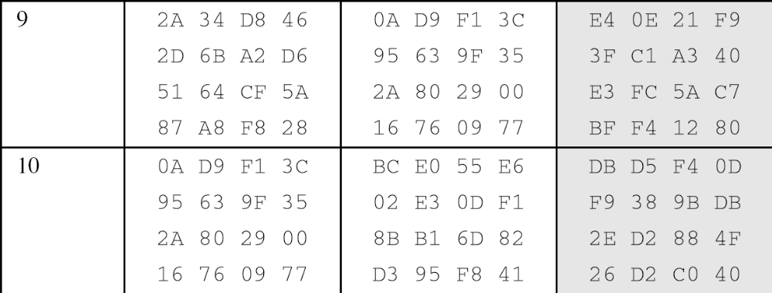
7-5 Continued
Example 7.10
Continued
7.<number>

Slide 59
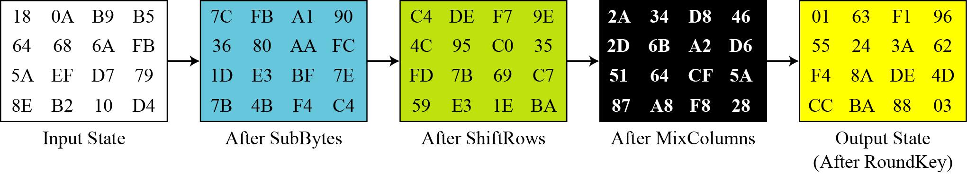
7-5 Continued
Example 7.11
Figure 7.21 shows the state entries in one round, round 7, in Example 7.10.
Figure 7.21 States in a single round
7.<number>

Slide 60
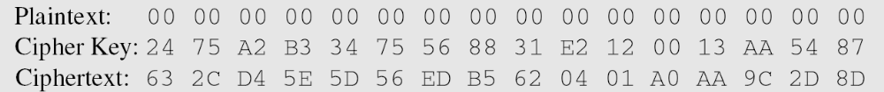
7-5 Continued
Example 7.12
One may be curious to see the result of encryption when the plaintext is made of all 0s. Using the cipher key in Example 7.10 yields the ciphertext.
7.<number>

Slide 61
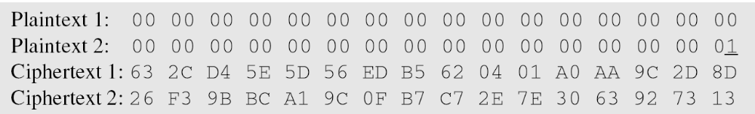
7-5 Continued
Example 7.13
Let us check the avalanche effect that we discussed in Chapter 6. Let us change only one bit in the plaintext and compare the results. We changed only one bit in the last byte. The result clearly shows the effect of diffusion and confusion. Changing a single bit in the plaintext has affected many bits in the ciphertext.
7.<number>

Slide 62
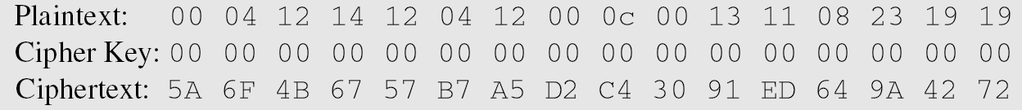
7-5 Continued
Example 7.14
The following shows the effect of using a cipher key in which all bits are 0s.
7.<number>

Slide 63
7-6 ANALYSIS OF AES
This section is a brief review of the three characteristics of AES.
Topics discussed in this section:
7.6.1 Security
7.6.2 Implementation
7.6.3 Simplicity and Cost
7.<number>

Slide 64
7.6.1 Security
AES was designed after DES. Most of the known attacks on DES were already tested on AES.
Brute-Force Attack
AES is definitely more secure than DES due to the larger-size key.
Statistical Attacks
Numerous tests have failed to do statistical analysis of the ciphertext.
Differential and Linear Attacks
There are no differential and linear attacks on AES as yet.
7.<number>

Slide 65
7.6.2 Implementation
AES can be implemented in software, hardware, and firmware. The implementation can use table lookup process or routines that use a well-defined algebraic structure.
7.<number>

Slide 66
7.6.3 Simplicity and Cost
The algorithms used in AES are so simple that they can be easily implemented using cheap processors and a minimum amount of memory.
7.<number>

